Slide 1
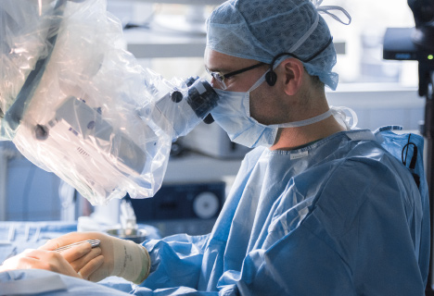
Augmented Reality in the Operating Room Registering Surgical Microscope Images with a CT Scan
Lars Jebe | 18 December 2018 | Stanford University
Notes:
Goal: AR
This is the initial registration only
We see a model here, this is used throughout the presentation

Slide 2
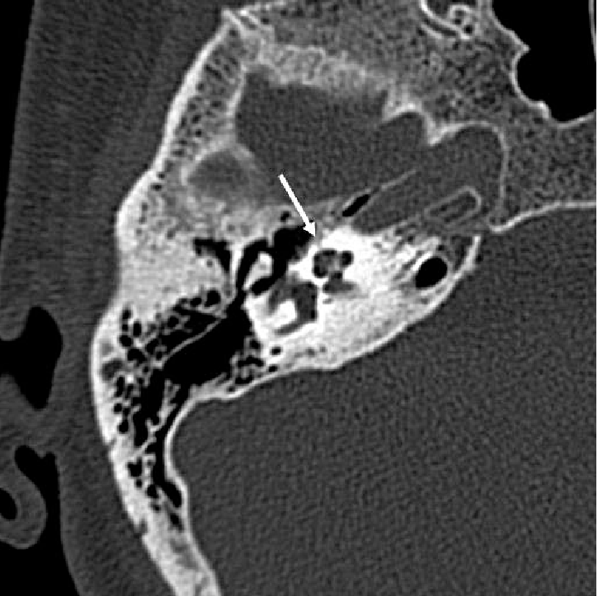
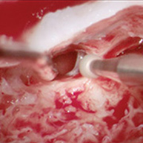
Giving “X-ray vision” to the surgeon
Main Problem: Initial Registration

Slide 3
Temporal Bone Phantom

Slide 4
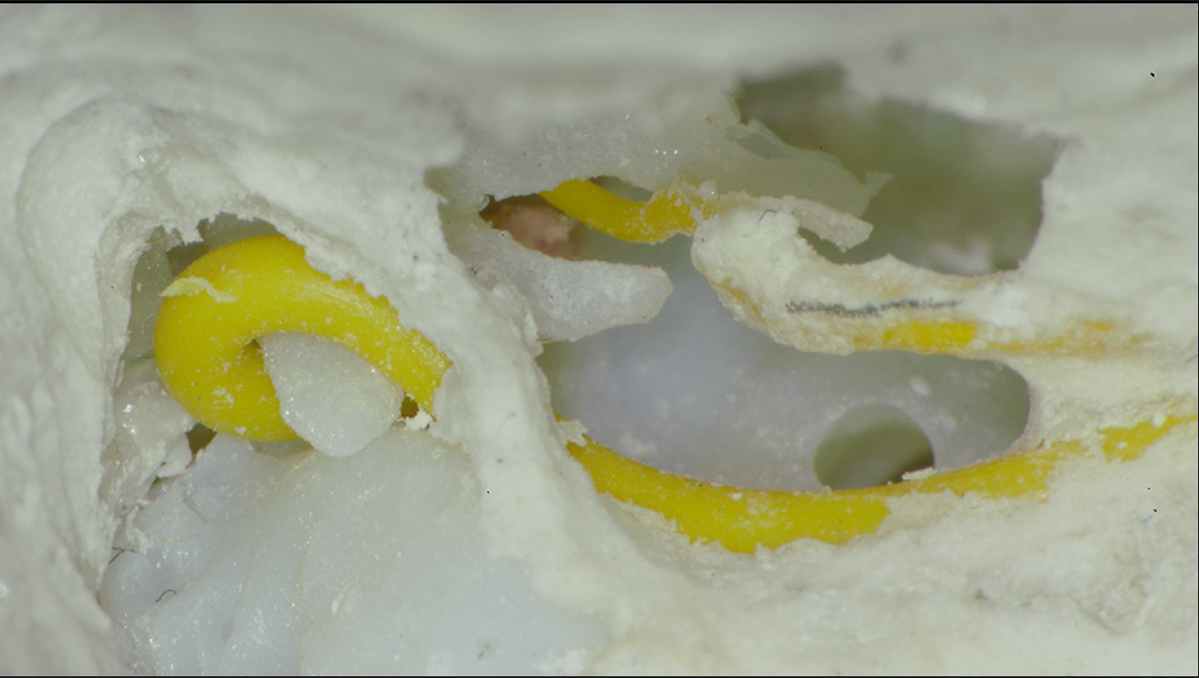
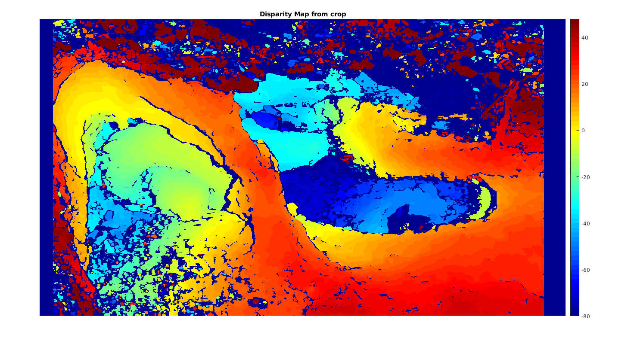
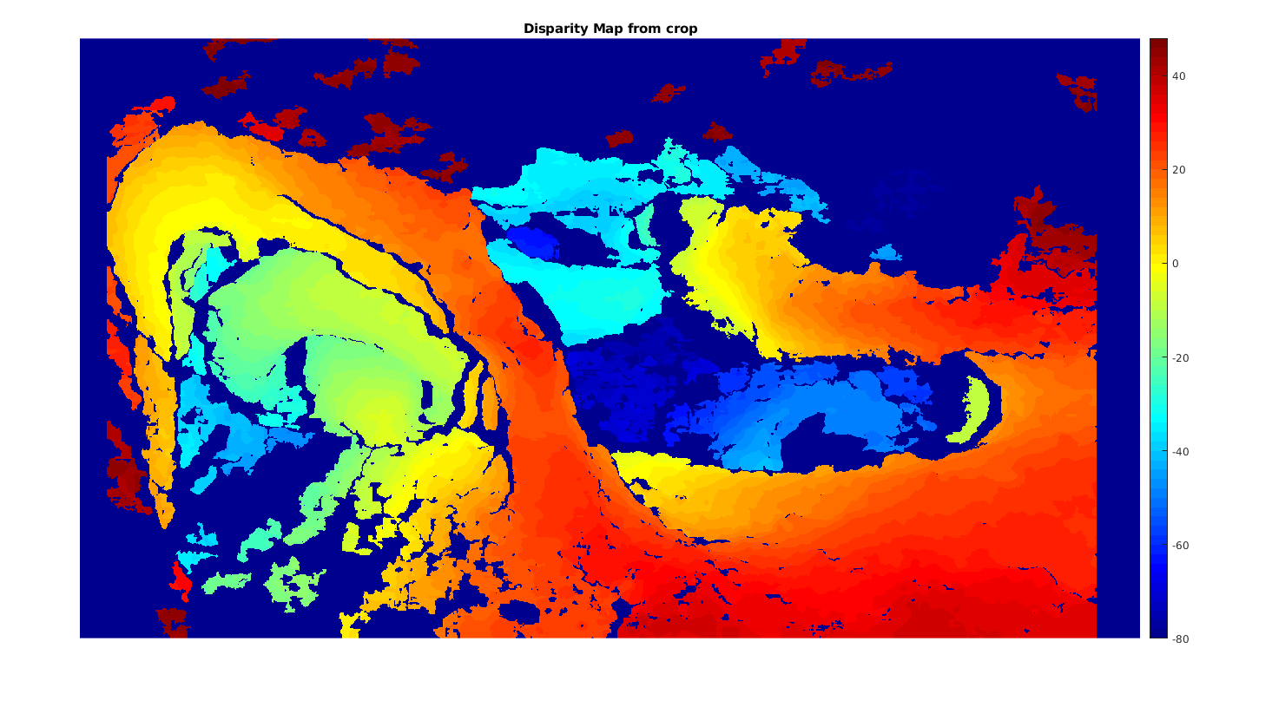
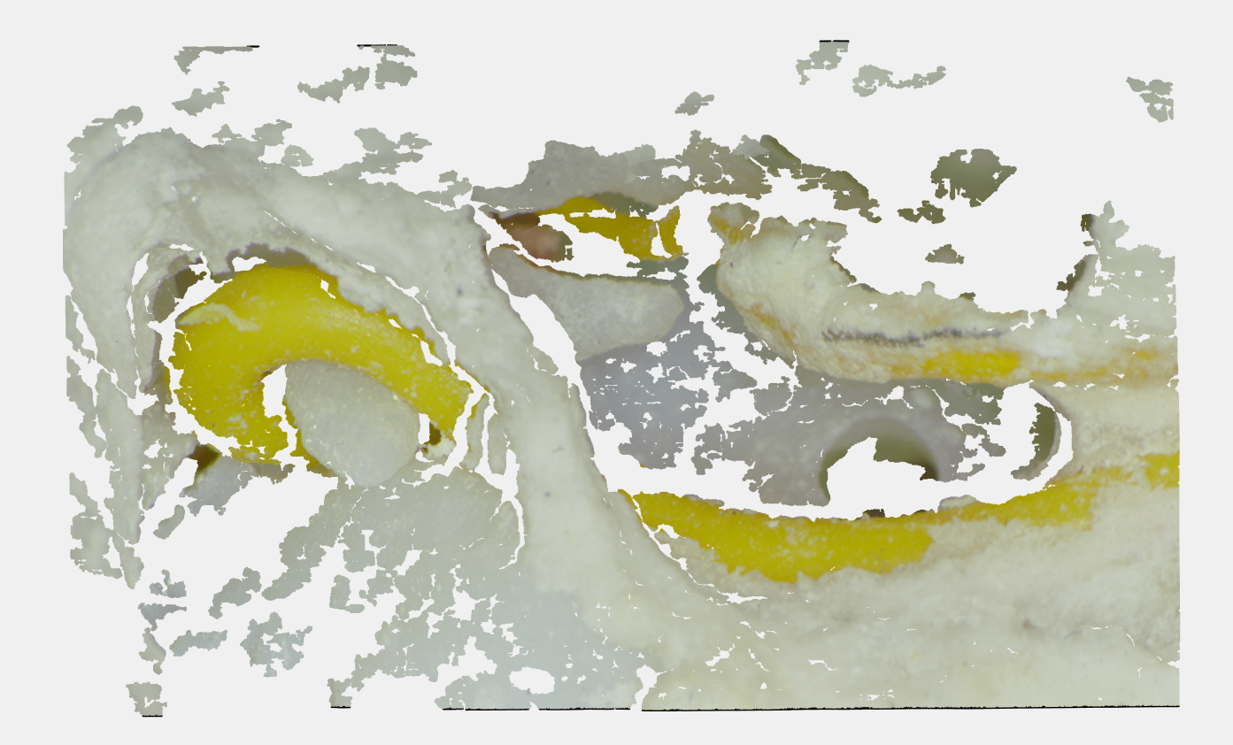
Stereo-Image to 2.5D Point Cloud
Rectify
Estimate Disparity
Convert to 3D Coordinates
Refine Disparity Map
Grayscale Small Region
Removal
Disparity to Depth,
Perspective – Orthographic,
Downsample
Using camera parameters
Block Matching

Slide 5
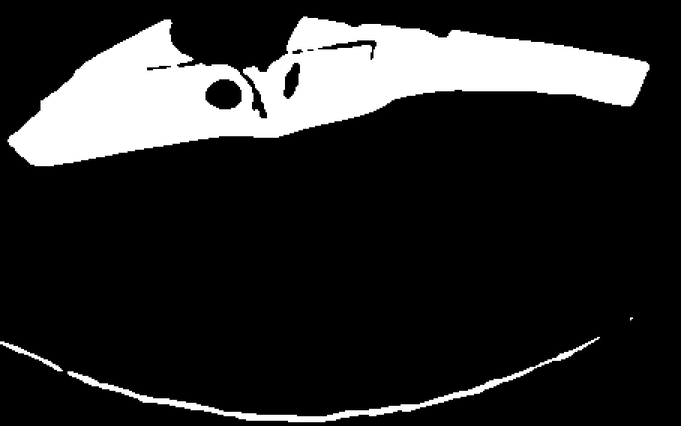
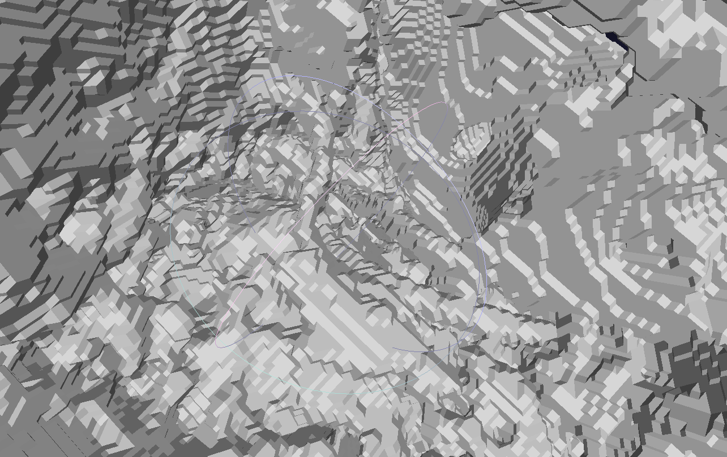
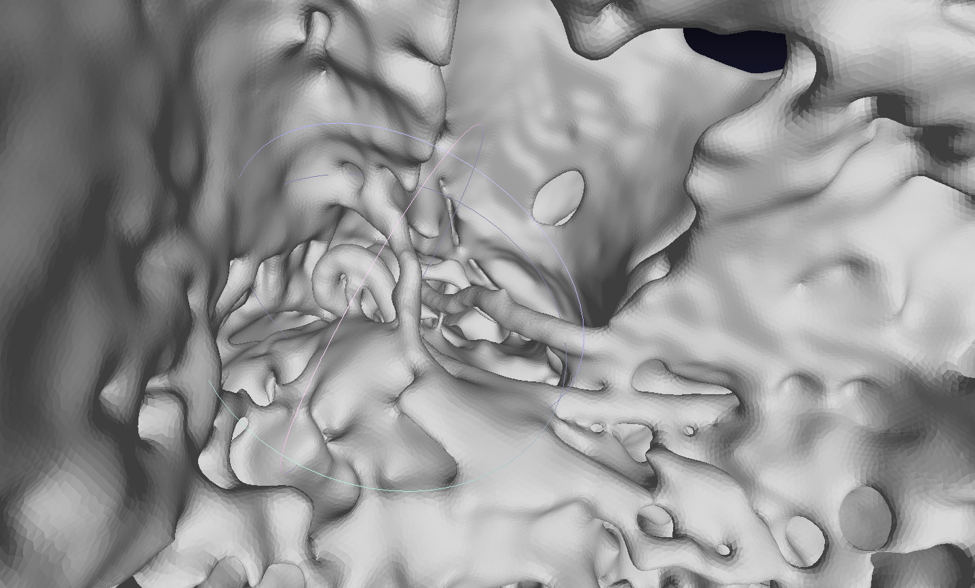
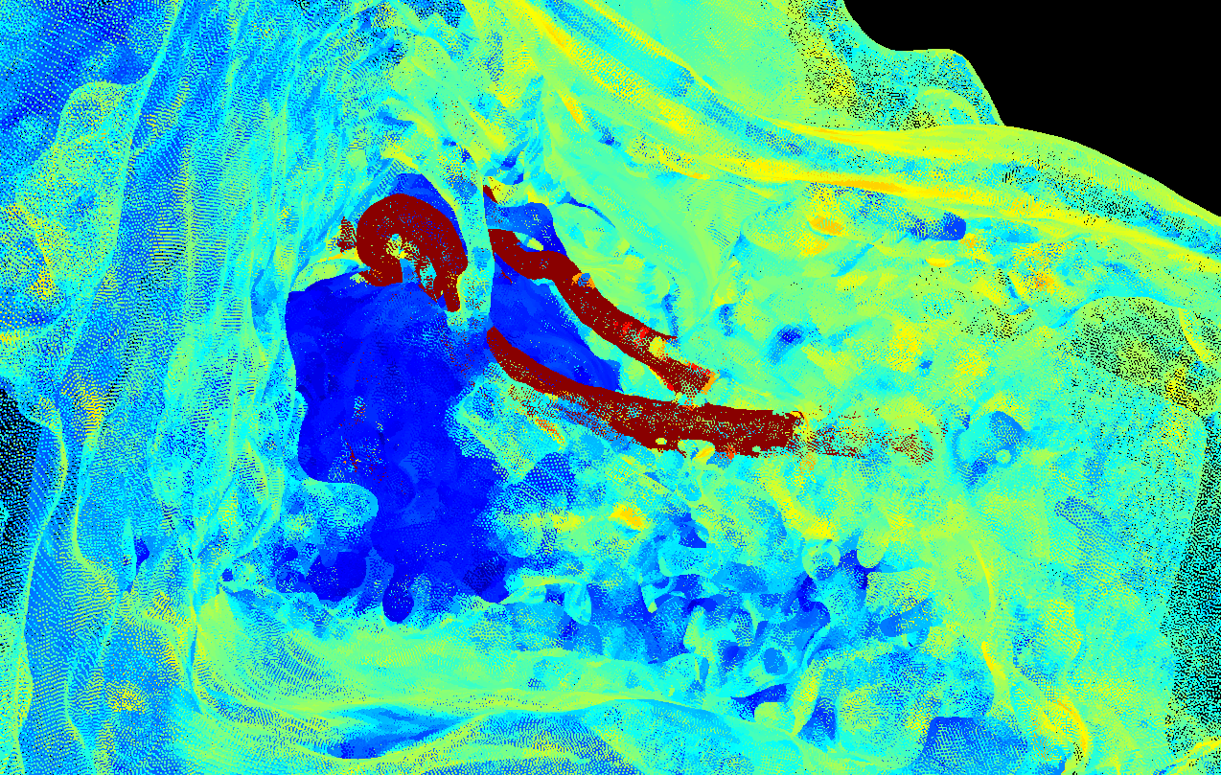
CT-Scan to 3D Surface Point Cloud
Binarize & Fill Holes
Convert to Surface Mesh
Smooth Mesh
Sample Surface Points
Thresholding,
3D small region removal
Simple ITK function
Laplacian Smoothing
Vertices,
Triangle Centers
Notes:
ITK = Insight Segmentation & Registration Toolkit
Color just for visualization

Slide 6
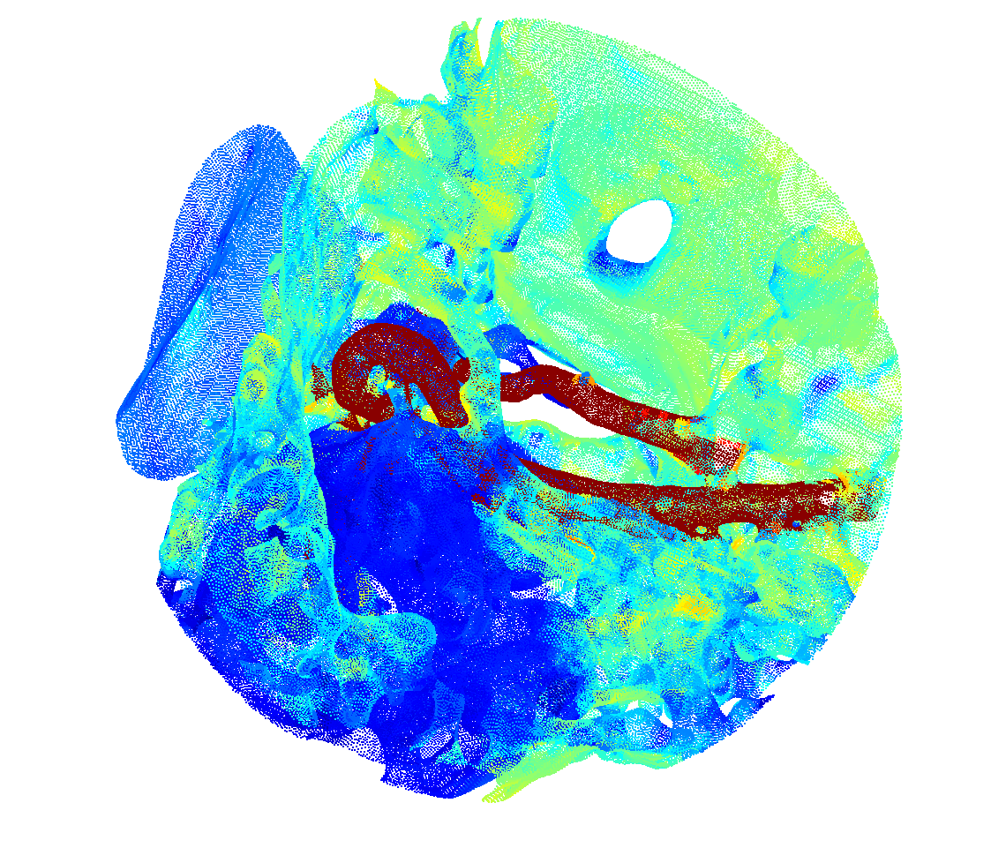
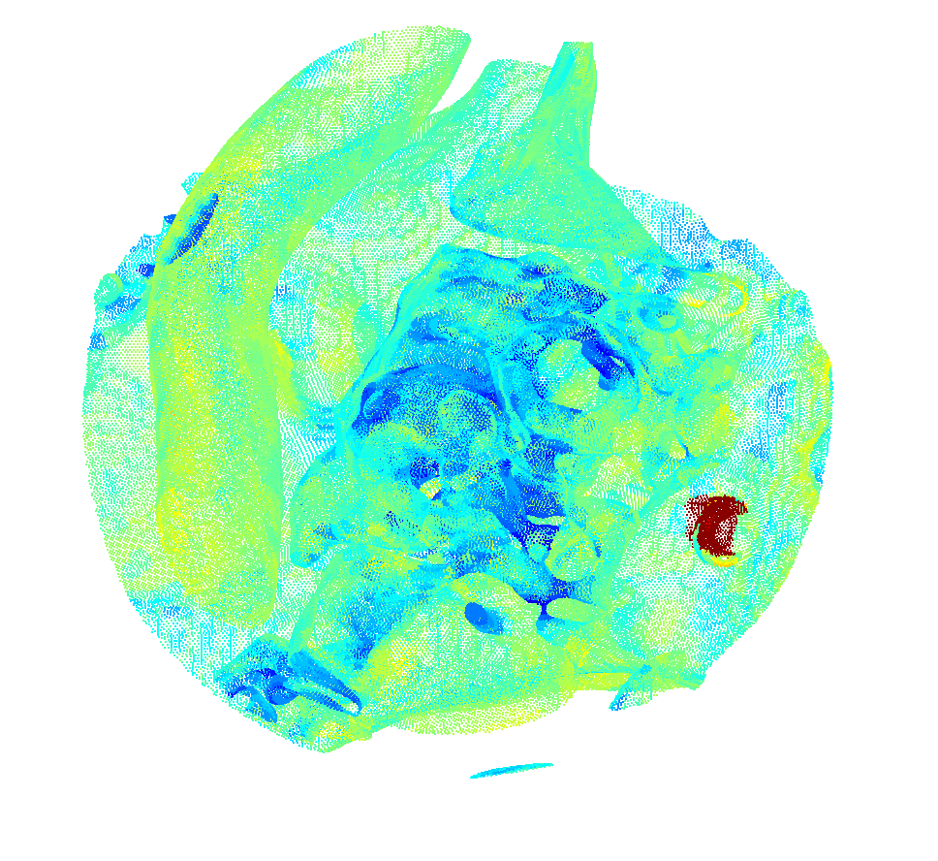
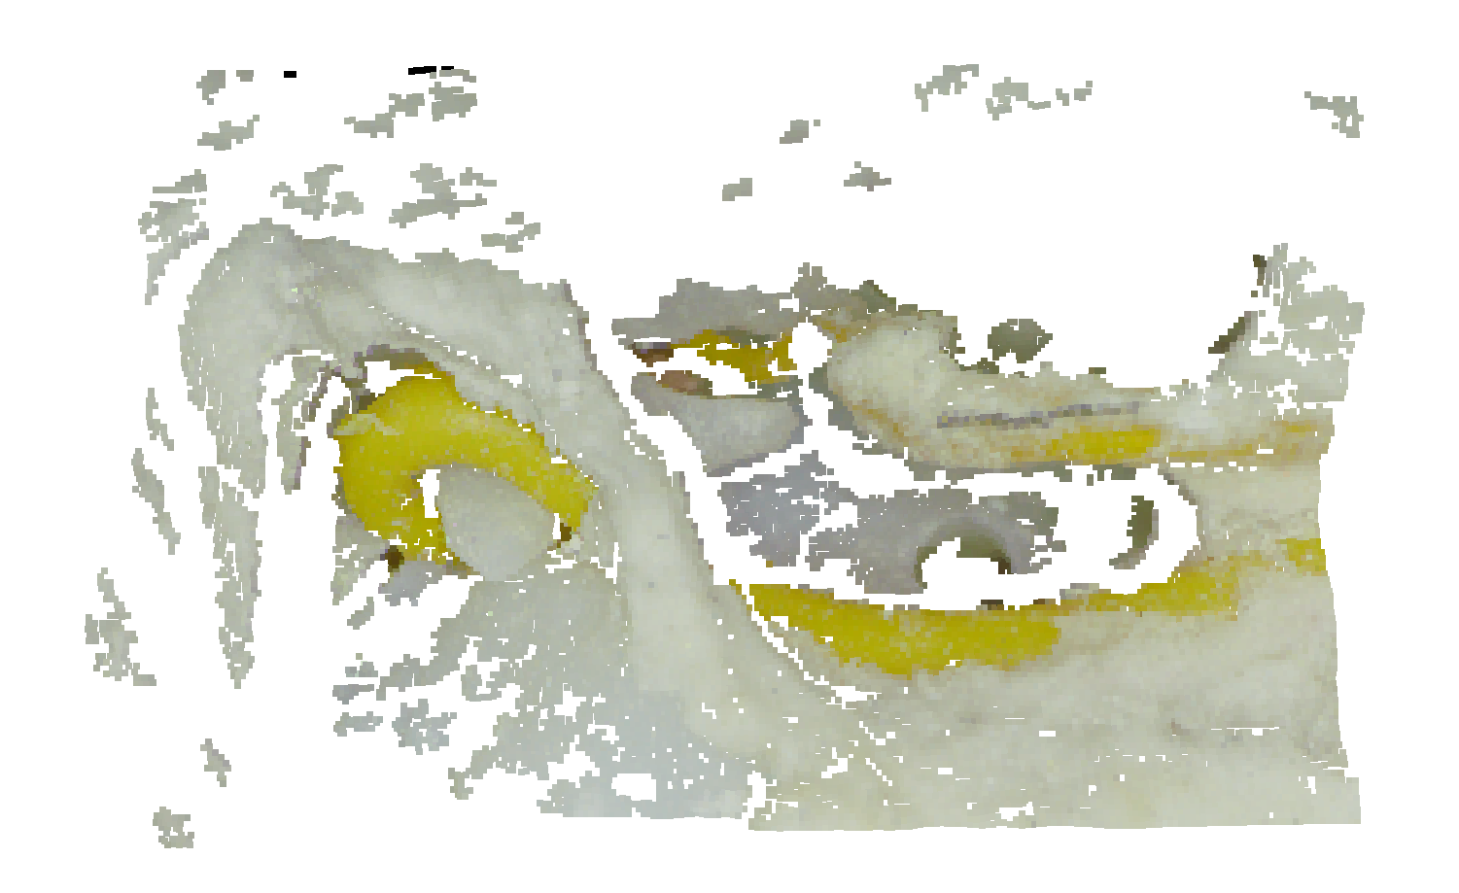
Experiment Setup for Design of Registration Algorithm
3D Random Crop
2.5D Query (“Surface”)
3D Correct Crop (“Model”)
Contains Query Surfaces
Contains 90% "Clutter"
Similar statistics to correct crop
Does not contain any query surfaces
Downsampled to match point density of 3D model
Notes:
Why spherical?
2 goals: retrieve correct sphere, and get correct alignment!

Slide 7
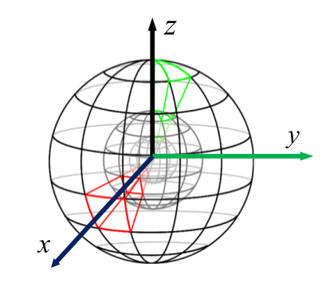
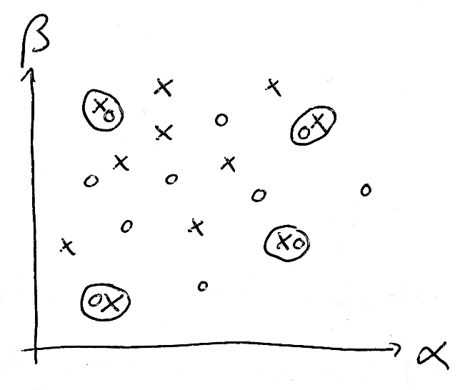
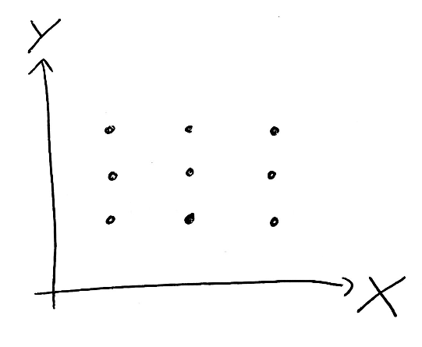
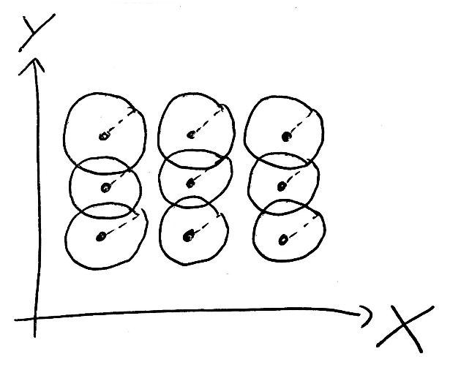
Approach: Local 3D Descriptor Matching
Keypoint Detection
Define Local Support Region
Calculate Descriptors
Match Descriptors
Random Uniform Sampling,
Quality Check
Spherical Support,
20-fold overlap
Histogram of Spatial Point Distribution
"L0.6"-distance,
Soft normalization,
SIFT matching method

Slide 8
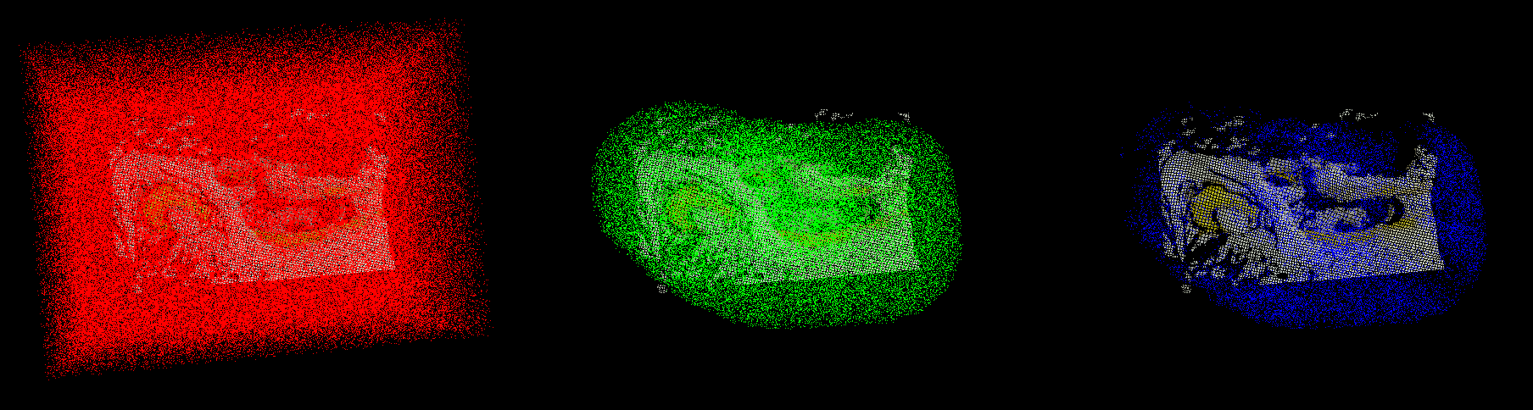

Sampling unique & information rich keypoints
Sample Candidate Points
Point Count Criterion
Eccentricity Criterion
Random Uniformly
$$N_{min}<N< N_{max}$$
Ratio of Eigenvalues of Covariance Matrix
247,626 pts
61,001 pts
21,313 pts
Notes:
What’s important / new? Samples are NOT bound to existing points!
Why point count criterion? Explain especially Maximum!
Why Eccentricity?

Slide 9
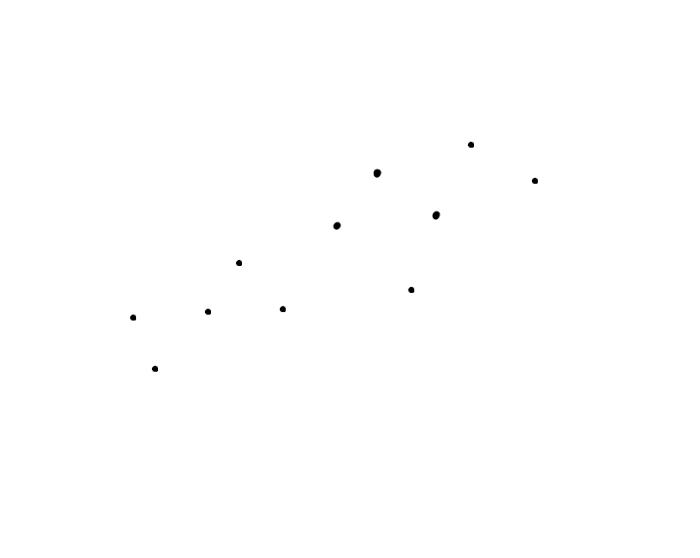
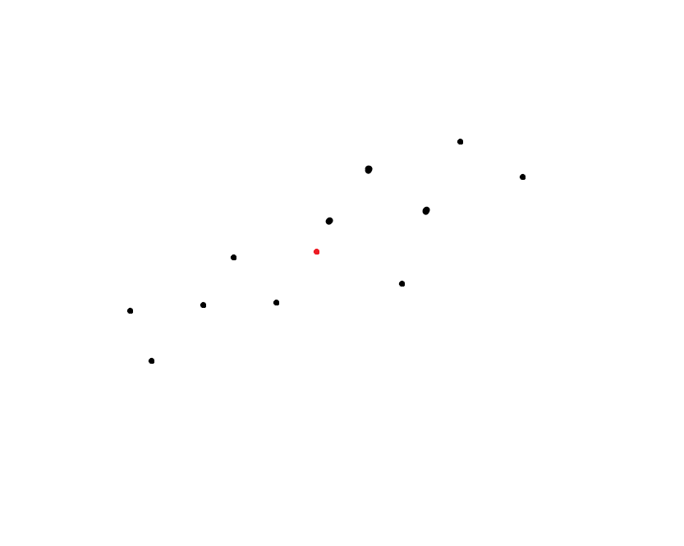
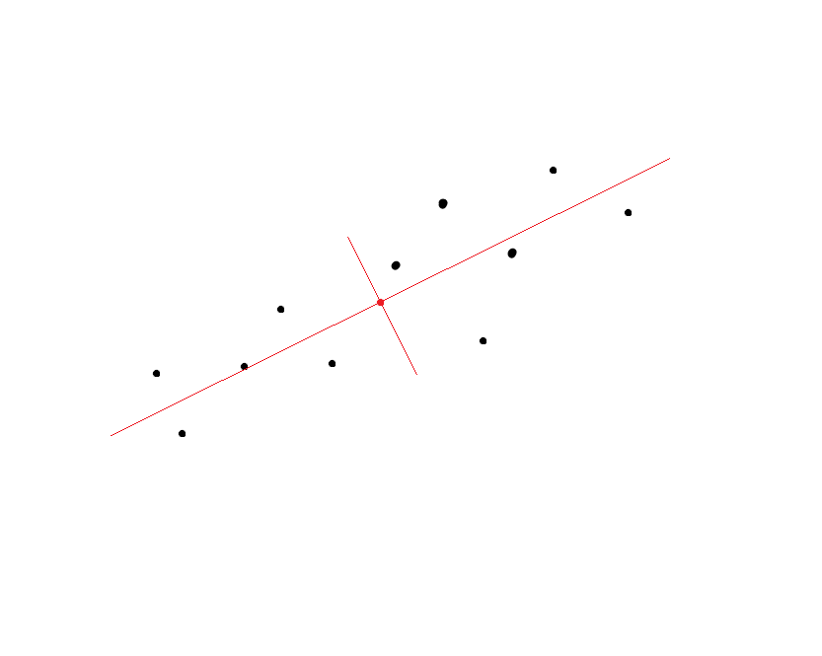
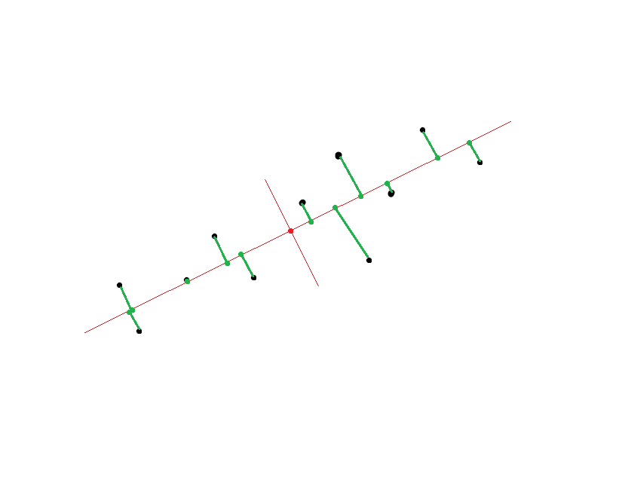
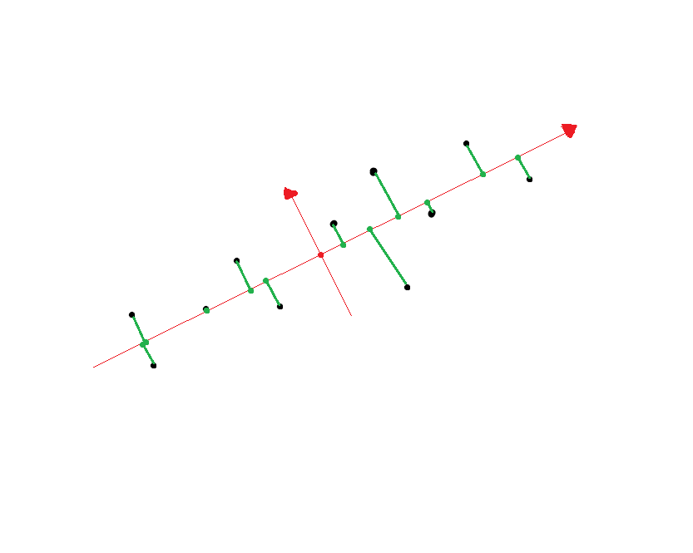
Align to local RF for Rotation Invariance
Find centroid
Construct reference frame from eigenvectors of point covariance matrix (PCA)
Determine signs of eigenvectors by counting point projections

Slide 10
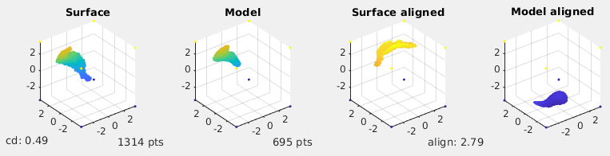
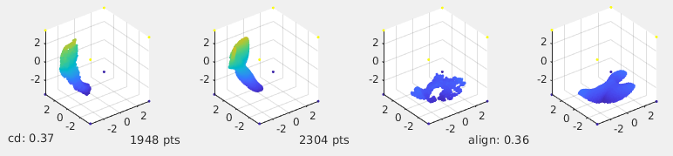
Align to local RF for Rotation Invariance
Alignment Failure
Alignment Success

Slide 11
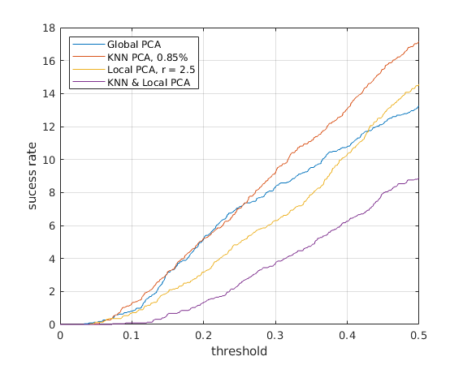

Improving Rotation Invariance
Alignment Success in %
Main Problem: Clutter
For robustness to clutter and outliers: use 85% closest points to centroid (KNN PCA)
Alternatively: Use points within certain distance to centroid (Local PCA)
Success, if smaller than the threshold

Slide 12
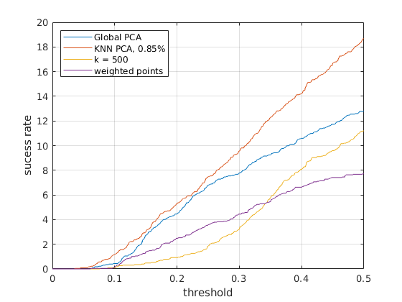
Improving Rotation Invariance
Alignment Success in %
[Mitra et al., 2004] proposes k-Nearest Neighbors (for local RA, not RF)
[Tombari et al., 2010] proposes weighting points by distance from centroid
KNN PCA with 0.85% works better here
Success, if smaller than the threshold
Notes:
Why KNN PCA better? IF points overlap, they’re very good. Outliers are very bad. Hard threshold makes more sense
Constant k difficult because of point count difference

Slide 13
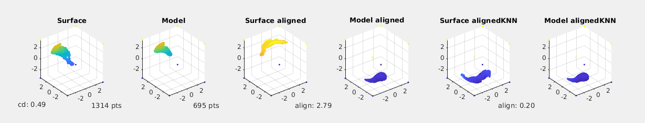
KNN PCA improves rotation invariance
Alignment Strategy | Precision | # Inliers
Vanilla PCA + Sign | 12.5 % | 71
KNN PCA (85%) | 15.4 % | 56
Ground Truth Alignment | 57.4 % | 189
Ground Truth Alignment
Vanilla PCA fails
KNN PCA succeeds

Slide 14
Descriptors: Point Count Histogram
"Unique Shape Context" [Tombari et al., 2010]

Slide 15
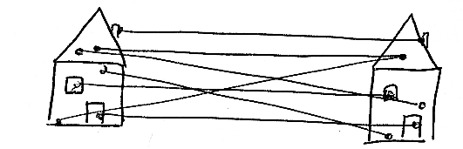
Finding Keypoint Correspondences
Normalization for robustness to point count
Matching distance metric for robustness to clutter
Nearest neighbor matching of descriptors
 | Precision | # Inliers
Vanilla SIFT Method | 9.3 % | 90
Soft L2-Normalization & L0.6-distance | 15.4 % | 56

Slide 16
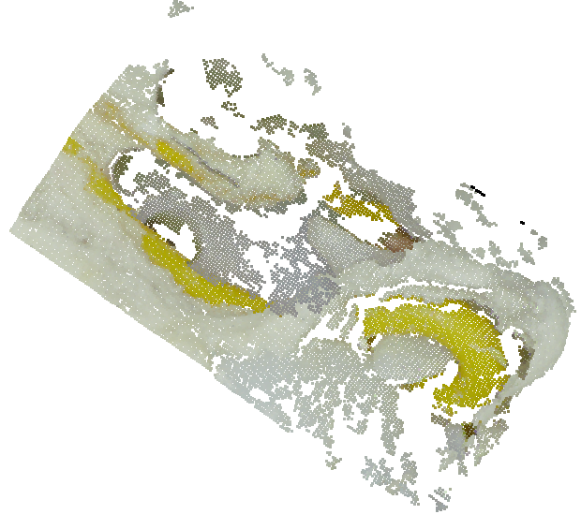
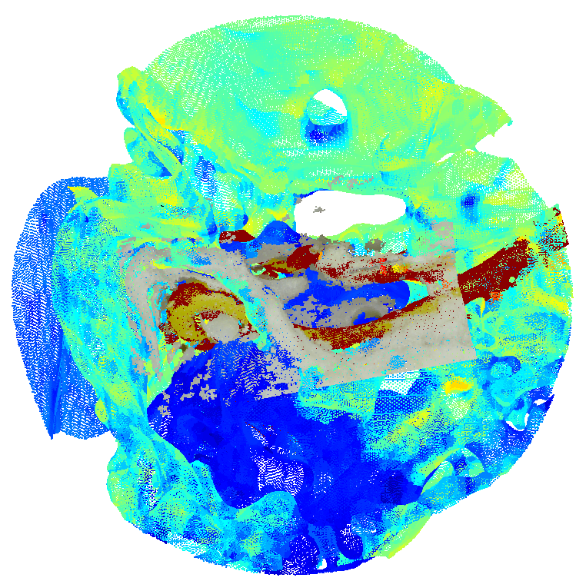
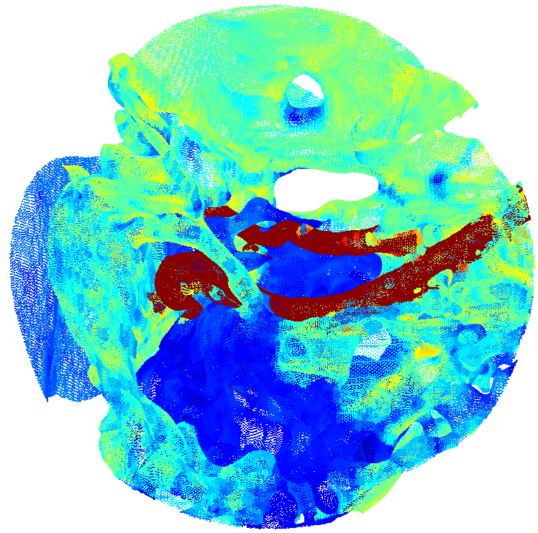
Estimating the transformation
RANSAC
Least squares estimation of 3D rigid body transform between point correspondences [Eggert, 1997]
3D Model crop with registered 2.5D Surface
Notes:
Alpha = 2

Slide 17
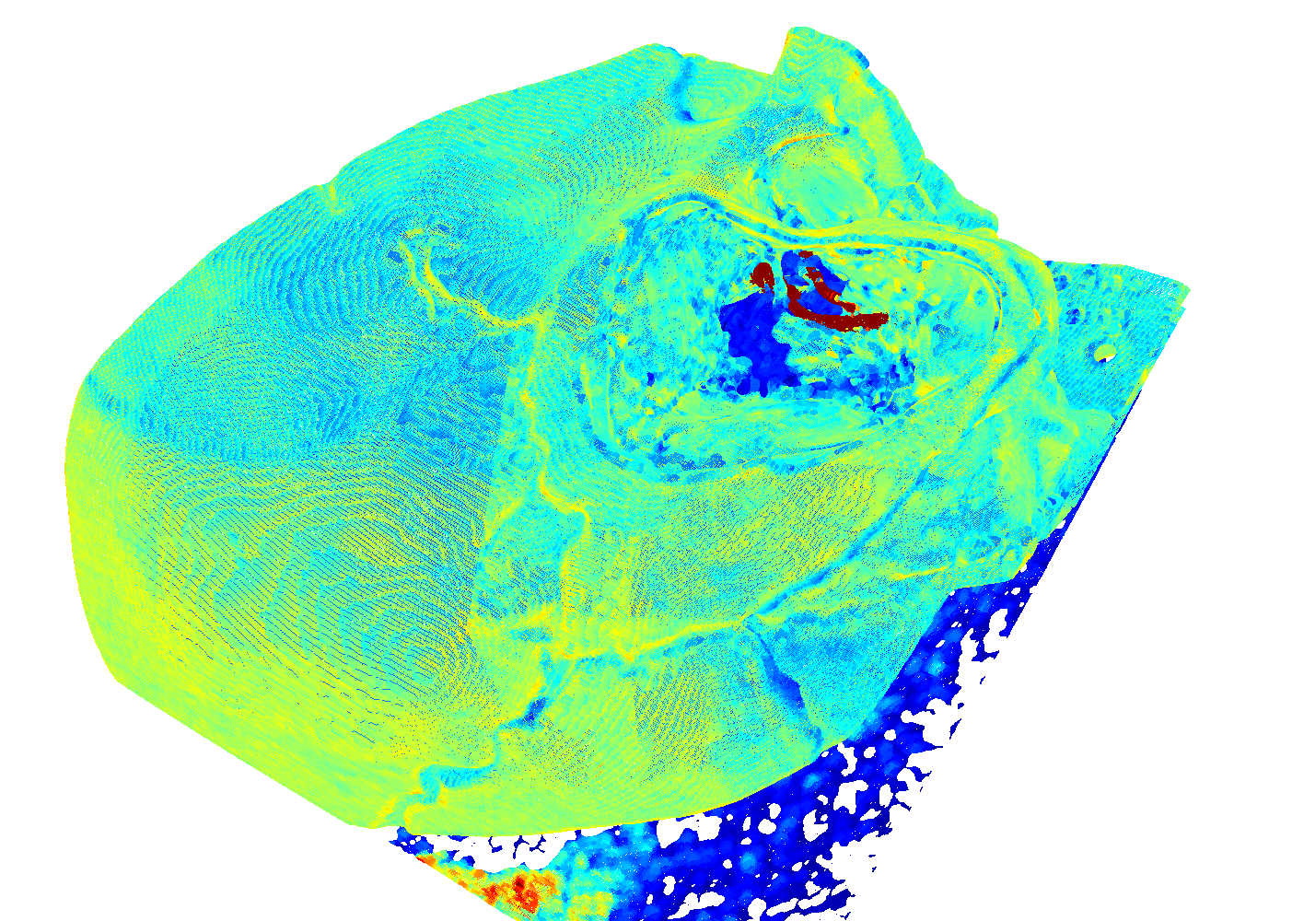
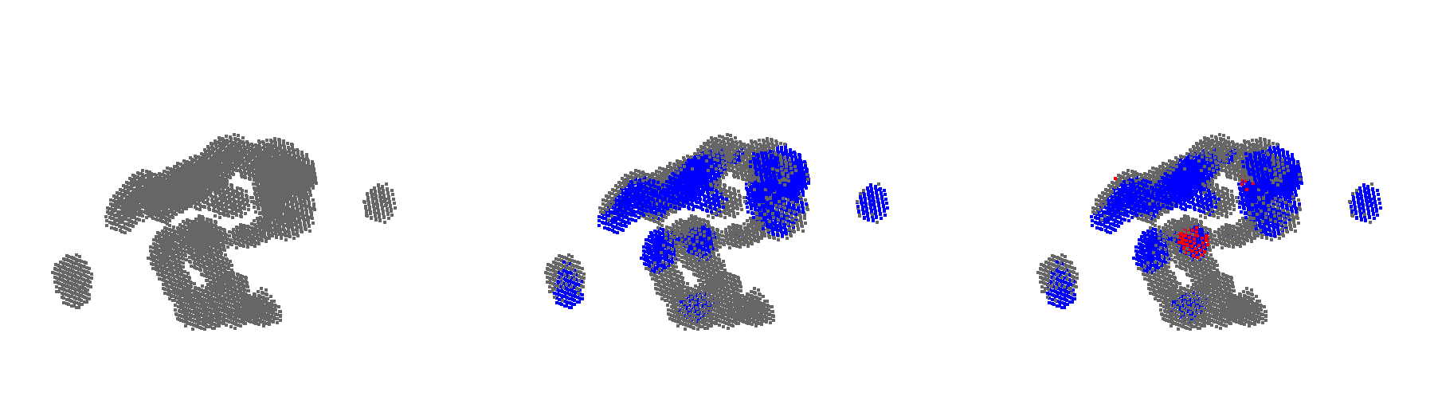
Retrieval on the whole model
So far, only considered one correct and one incorrect "database entry"
Calculate Descriptors
Match Spherical Subsets with Query
Retrieve Candidates
Geometric Consistency Check
Full Model
Center positions of spherical crops
Positions with most Putative Matches (blue)
Position where RANSAC found a transformation (red)

Slide 18
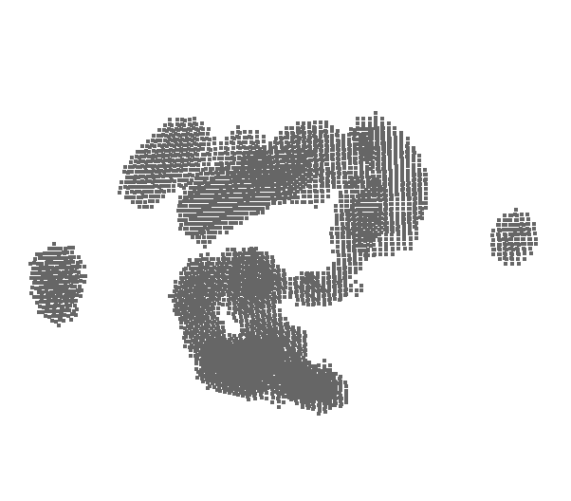
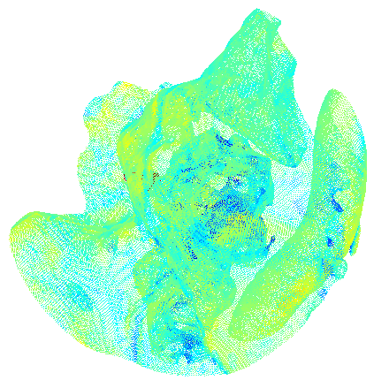
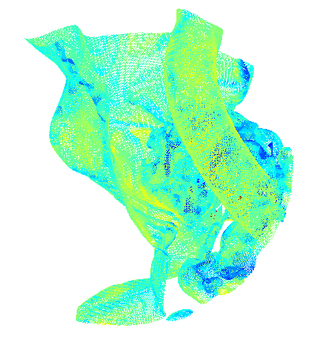
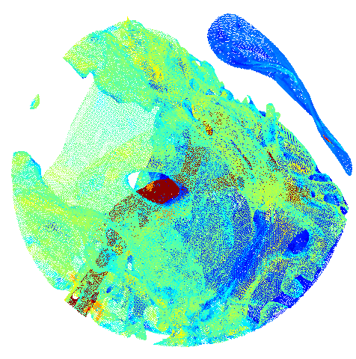
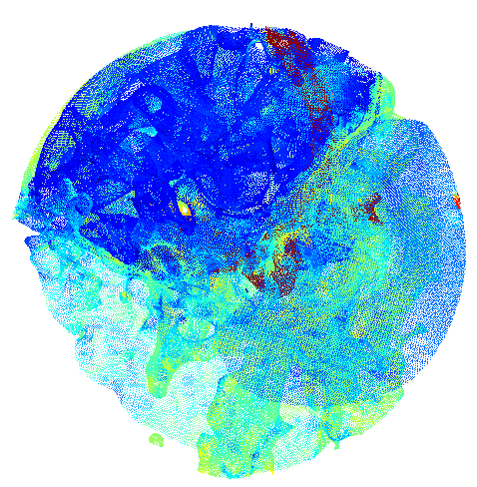
Sampling Spherical Subsets
Containing at least a minimum number of local descriptors
Match query to each one

Slide 19
Finding the matching region
5730 Matching Candidates
2773 RANSAC Candidates
61 RANSAC Successes
Consider only positions with most putative matches (blue)
Geometric Consistency Check on candidate positions

Slide 20
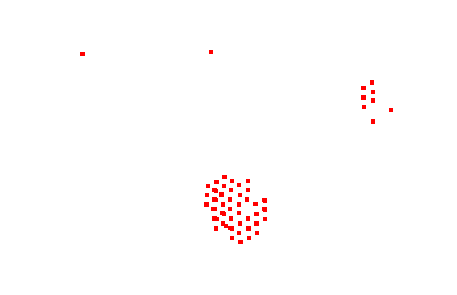
Obtaining the final transformation
Cluster
Aggregate all inlier matches from largest cluster
Run RANSAC again to obtain final transformation
61 RANSAC Successes
47 Correct Hits

Slide 21
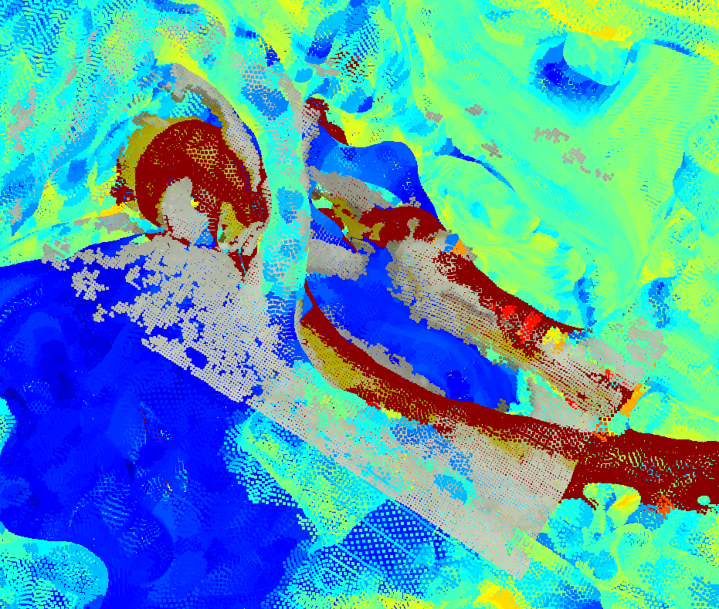
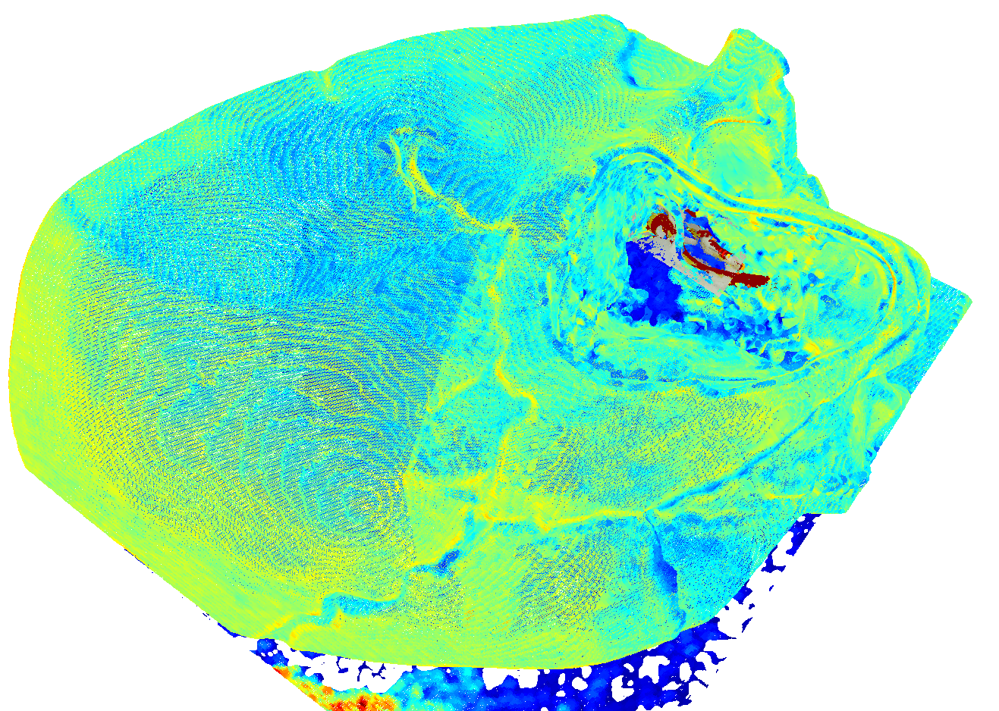
Allignment correct with +-1mm margin

Slide 22
Remember this?
Alignment Strategy | Precision | # Inliers
Vanilla PCA + Sign | 12.5 % | 71
KNN PCA (85%) | 15.4 % | 56
Ground Truth Alignment | 57.4 % | 189
Great way to check if alignment is correct
Check correctness: Use global alignment for descriptors and match again: 51.3 % inliers!

Slide 23
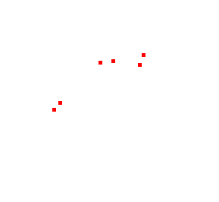
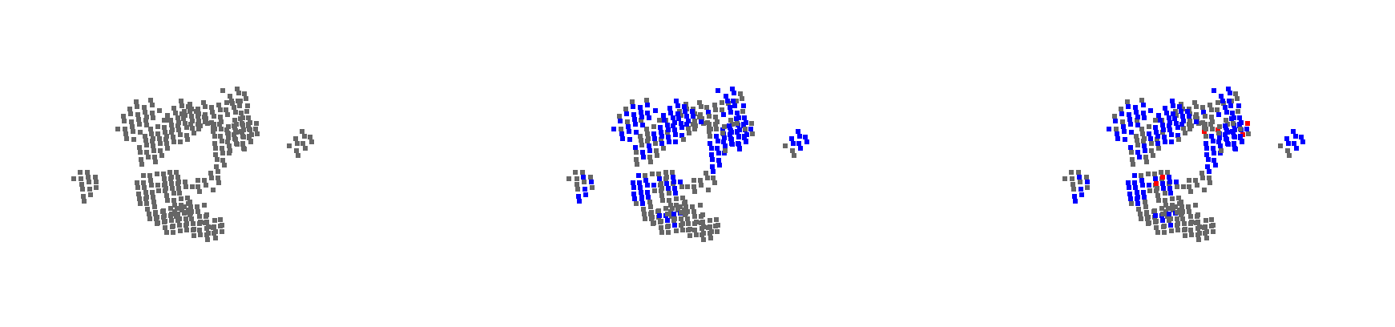
Speeding it up
366 Matching Candidates
168 RANSAC Candidates
6 RANSAC Successes
2 Correct Hits
Sparser sampling
Cluster
Check using globally aligned descriptors
Refine
Double check: Refinement transformation should be close to identity
16 % (1%)
37% (0%)
51% (19%)
Inlier-Ratio
permissive (strict)

Slide 24
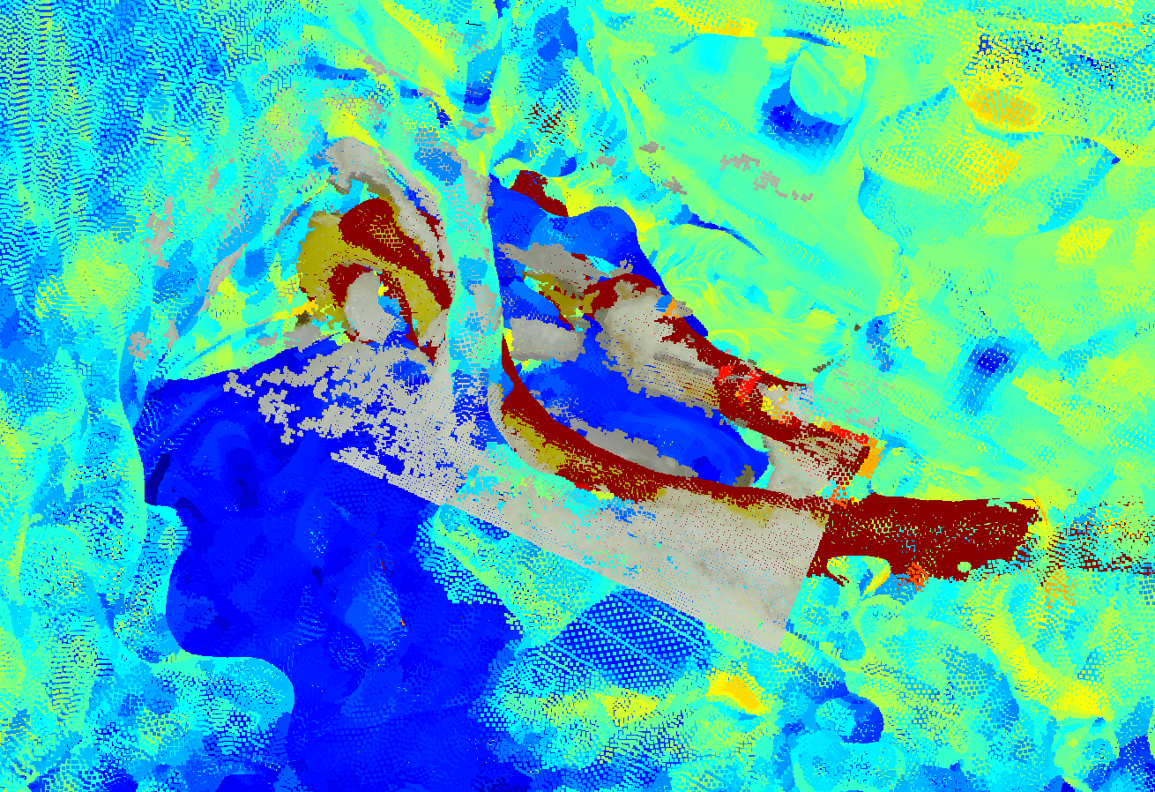
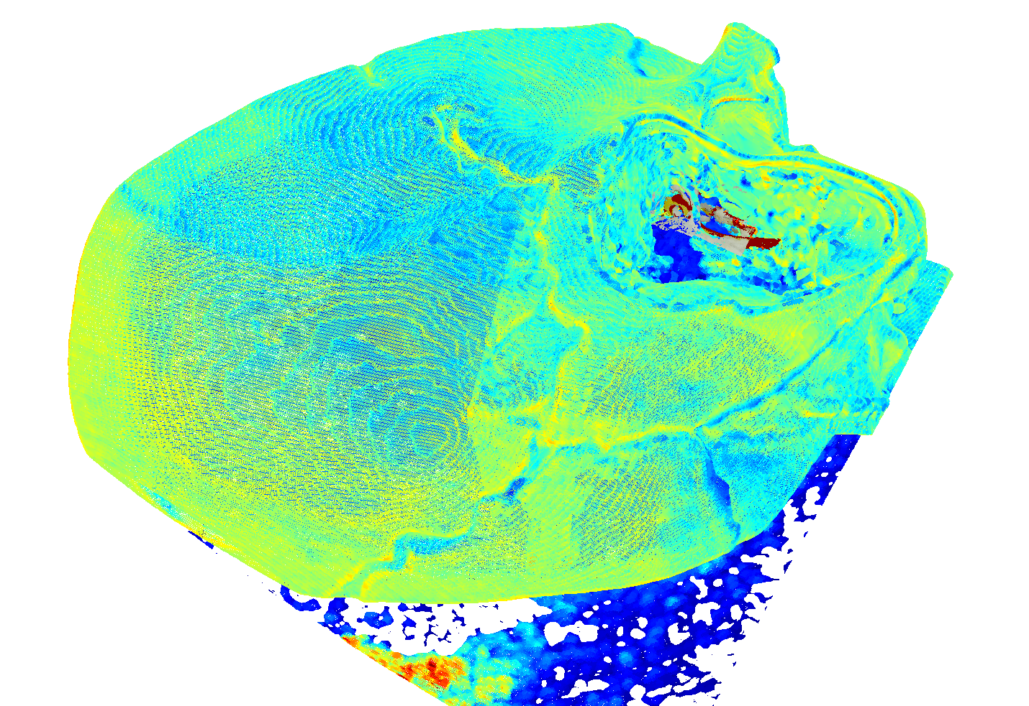
Allignment correct with +-0.5mm margin

Slide 25
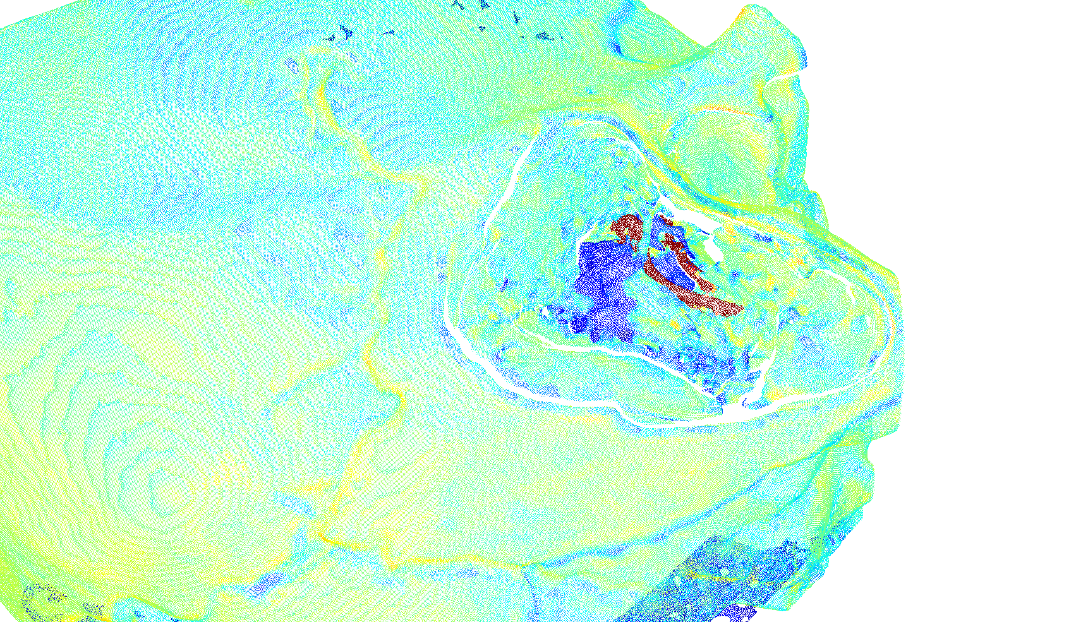
Further Improvement: Rendering Visible Points Only

Slide 26
Approach
Define camera parameters (6D Position, FOV etc.)
1
Repeat with different camera parameters
3
Render view to obtain visible surfaces
2
Union over visible surfaces
4
Re-sample points
5

Slide 27
Results
Experiment | Precision | # Inliers
Best so far | 15.4 % | 56
Render | 24.4 % | 313
Ground truth alignment, best so far | 57.4 % | 189
Ground truth alignment, render | 70.2 % | 798

Slide 28
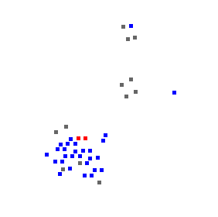
Results (Whole Model)
42 Matching Candidates
36 RANSAC Candidates
2 RANSAC Successes
2 Correct Hits

Slide 29
Next steps
Incorporate structured light to obtain better depth maps
1
Develop strategy for automatically segmenting tissue/ non-rigid material
3
Test algorithm on real patient datasets
2
Motion Tracking after Initial Registration is successful
4

Slide 30
Thank you ☺

Slide 31
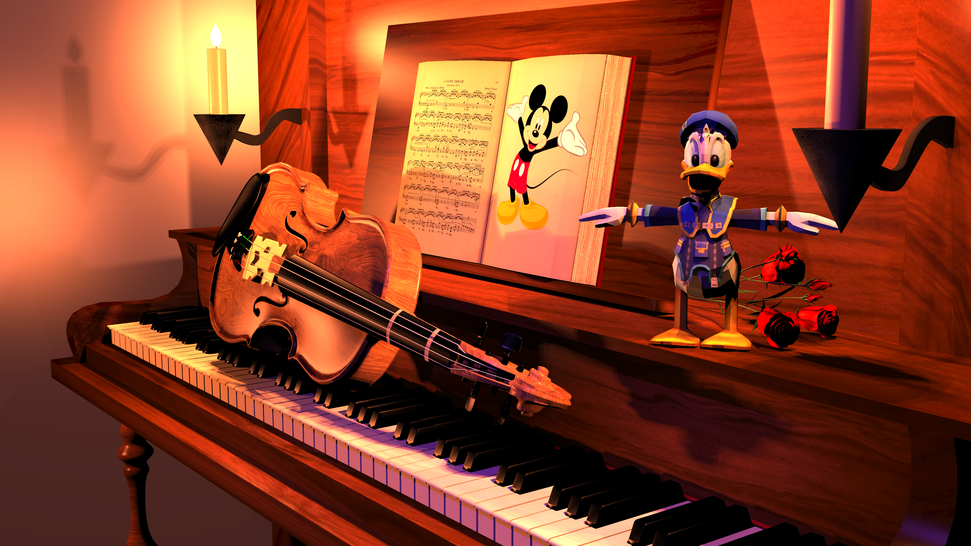
Thank you ☺

Slide 32
Further ideas for improvement
Definition of local descriptor neighborhood based on mesh neighbors, rather than spherical support region
1
3D-Model: Render only points from mesh that are visible from the outside to reduce clutter
2

Slide 33


Point Covariance Matrix
unweighted
weighted
[Tombari et al., 2010]

Slide 34







Estimating the 3D rigid transformation
From centered point sets
and
Singular value Decomposition
Minimizes this:
[Eggert et al., 1997]

Slide 35
Descriptors: Point Count Histogram
"Unique Shape Context" [Tombari et al., 2010]
Using binning of (10, 7, 14) for radial, elevation, azimuth dimension
Binning slightly reduced compared to author's recommendation --> less descriptiveness, more robustness, faster matching

Slide 36



Finding Correspondences
Normalization makes the difference
Custom normalization by appending constant to descriptor
Constant value is with parameter , is average descriptor length
Matching metric is important for robustness to clutter
 | Precision w/ Correct Crop | # Inliers w/ Correct Crop | # "Inliers" w/ Random Crop
Vanilla SIFT Method | 9.3 % | 90 | 0
L1-distance | 10.2 % | 72 | 1
L0.6-distance | 12.0 % | 80 | 0
Custom normalization + L0.6-distance | 15.4 % | 56 | 0

Slide 37
Estimating the transformation
RANSAC
Least squares estimation of 3D rigid body transform between point correspondences [Eggert, 1997]
RANSAC Parameters | Value
# of sampled points | 3
# of iterations | 30k
min. Inlier-Ratio | 10 %
Inlier-Distance | 0.2 mm
3D Model crop with registered 2.5D Surface
Notes:
Alpha = 2

Slide 38

Determining Sampling Density
Slide sphere in random direction and match
Average over many different random directions
0
1
Notes:
Database entry = “spherical subset”
Dense: 10 fold – overlap. Sparse: 4-fold overlap.

